Slide 1
Chapter 4: Decision Analysis
Lecture 12
Institute of Engineering
Asst. Prof. Anita Prajapati, Ph.D.
14 July 2023

Slide 2
Decision Analysis
Chapter 15
Spreadsheet Modeling & Decision Analysis:
A Practical Introduction to Management Science, 3e
by Cliff Ragsdale
15-<number>

Slide 3
Introduction to Decision Analysis
We have learnt many techniques in this course that can help managers and engineers gain insight and understanding about decision problems. But models do not make decisions – people have to do.
Models help managers gain insight and understanding, but they can’t make decisions.
Decision making often remains a difficult task due to:
  uncertainty regarding the future
  conflicting values or objectives
15-<number>

Slide 4
Deciding Between Job Offers
Consider the following example..., after your graduation, you are offered a job in
Company A
    In a new industry that could boom or bust.
    Low starting salary, but could increase rapidly.
    Located near friends, family and favorite sports team.
Company B
    Established firm with financial strength and commitment to employees.
    Higher starting salary but slower advancement opportunity.
    Distant location, offering few cultural or sporting activities.
What job would you like to join? A difficult decision to take
15-<number>

Slide 5
Decision Analysis
Making Good decisions involve defining alternatives, determining the preferences or values by which the decision will be based, and evaluating the alternatives. Managers with gut feeling will not be able to make good decisions all the time.
Decision Analysis is the formal study of how people make decisions, particularly when faced with uncertain information, as well as a collection of techniques to support the analysis of decision problems.
15-<number>

Slide 6
Decision Analysis
Main characteristics of decision situations
  They must be important. Decision analysis techniques should not be used for small decisions.
  They are probably unique. Usual decisions which happen regularly can be done with proper programming and delegation.
  They allow some time for study. Decision analysis techniques will not be useful when decisions have to be taken urgently.
15-<number>

Slide 7
Decision Analysis
Main characteristics of decision situations
  They are complex. They may have multiple objectives, requiring trade-offs between alternatives.
  They involve uncertainty and risk. Uncertainty is not knowing what will happen tomorrow. Risk is the uncertainty associated with an undesirable consequence, such as financial or physical loss.
15-<number>

Slide 8
Application of Decision Analysis
Environmental Impact Assessment
Capital –budgeting or investment
Research and development activities
Sports
15-<number>

Slide 9
Elements of Decision Problems
There are essentially three types of components to any decision problem.
    Decisions
    Uncertain events or outcomes
    Consequences or payoffs
15-<number>

Slide 10
Structuring Decision Problems
Structuring decision problems involves defining alternative decision that can be made, uncertain outcomes that may result, and criteria by which to evaluate the value of the various combinations decisions and outcomes.
15-<number>

Slide 11
Structuring Decision Problems
Generating alternatives
  A set of decisions should be there so that a decision maker can select the optimal. Managers must ensure that they have considered all possible options so that the ‘best’ one will be included in the list.
Alternatives - different courses of action intended to solve a problem.
    Work for company A
    Work for company B
    Reject both offers and keep looking
15-<number>

Slide 12
Structuring Decision Problems
Defining outcomes
  The second task in structuring decision problems is defining the outcomes, or events. These events occur once a decision is made and the decision maker has no control over them. Outcomes may be quantitative or qualitative.
States of Nature - future events not under the decision makers control.
    Company A grows
    Company A goes bust
    etc
15-<number>

Slide 13
Structuring Decision Problems
Decision Criteria
  Decision makers must have well-defined criteria on which to evaluate potential options. These criteria might be to maximize the net profit or social benefits, or to minimize the costs, or some measure of loss.
  The value of making a decision D and having event S occur is called the payoff and expressed as V(D,S).
Criteria - factors that are important to the decision maker and influenced by the alternatives.
    Salary
    Career potential
    Location
15-<number>

Slide 14
Payoff Matrix
A payoff matrix is a table that summarizes the final outcome or payoff for each decision alternative under each possible state of nature.
15-<number>

Slide 15
Decision Strategy (Rule)
Non-probabilistic methods
    Average Payoff Strategy (Average payoff rule)
    Aggressive Strategy (Maximax decision rule)
    Conservative Strategy (Maximin Decision rule)
    Opportunity Loss Strategy ( The Minimax regret decision rule)
15-<number>

Slide 16
An Example: Magnolia Inns
Hartsfield International Airport in Atlanta, Georgia, is one of the busiest airports in the world.
It has expanded numerous times to accommodate increasing air traffic.
Commercial development around the airport prevents it from building additional runways to handle the future air traffic demands.
Plans are being developed to build another airport outside the city limits.
15-<number>

Slide 17
An Example: Magnolia Inns (con’t)
Two possible locations for the new airport have been identified, but a final decision is not expected to be made for another year.
The Magnolia Inns hotel chain intends to build a new facility near the new airport once its site is determined.
Land values around the two possible sites for the new airport are increasing as investors speculate that property values will increase greatly in the vicinity of the new airport.
See data in file Fig15-1.xls
15-<number>

Slide 18
The Decision Alternatives
Buy the parcel of land at location A.
2) Buy the parcel of land at location B.
3) Buy both parcels.
4) Buy nothing.
15-<number>

Slide 19
The Possible States of Nature
The new airport is built at location A.
2) The new airport is built at location B.
15-<number>

Slide 20
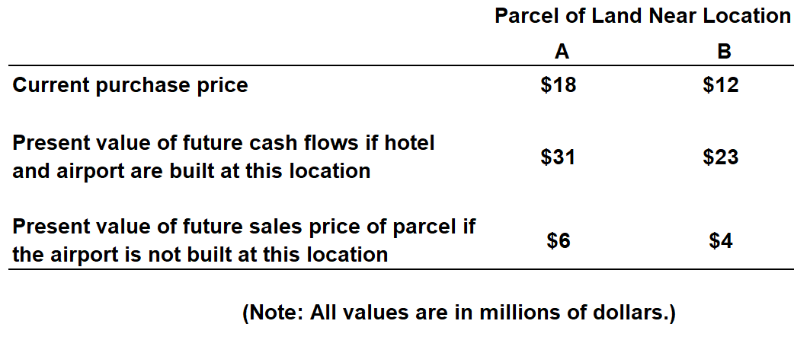
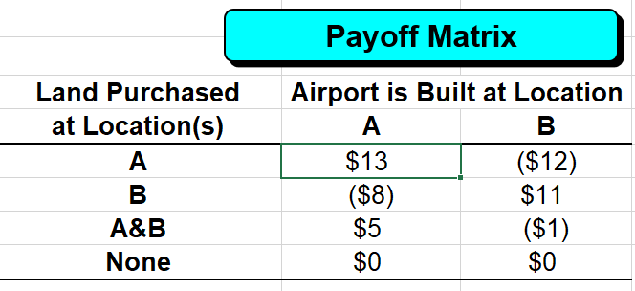
Constructing a Payoff Matrix
See file Fig15-1.xls
15-<number>

Slide 21
Decision Rules
If the future state of nature (airport location) were known, it would be easy to make a decision.
Failing this, a variety of non-probabilistic decision rules can be applied to this problem:
    Maximax
    Maximin
    Minimax regret
No decision rule is always best and each has its own weaknesses.
15-<number>

Slide 22
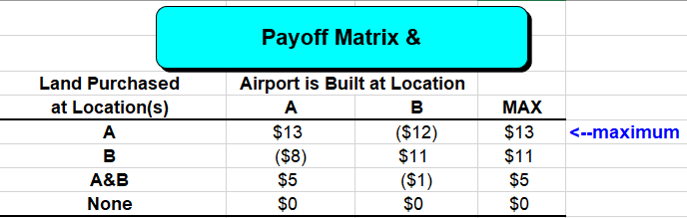
The Maximax Decision Rule
Identify the maximum payoff for each alternative.
Choose the alternative with the largest maximum payoff.
See file Fig15-1.xls
15-<number>

Slide 23
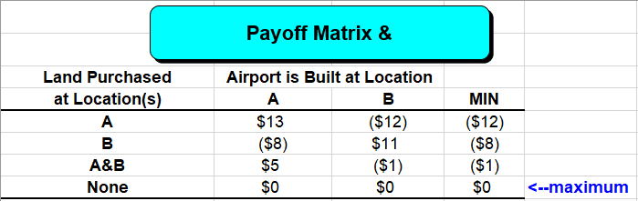
The Maximin Decision Rule
Identify the minimum payoff for each alternative.
Choose the alternative with the largest minimum payoff.
See file Fig15-1.xls
15-<number>

Slide 24
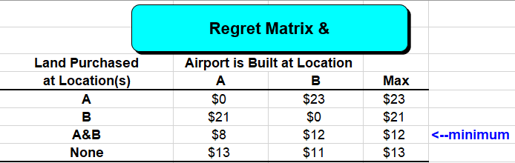
The Minimax Regret Decision Rule
Compute the possible regret for each alternative under each state of nature.
Identify the maximum possible regret for each alternative.
Choose the alternative with the smallest maximum regret.
See file Fig15-1.xls
=MAX(Payoffs!B$5:B$8)-Payoffs!B5
15-<number>

Slide 25
Anomalies with the Minimax Regret Rule
Consider the following payoff matrix
State of Nature
Decision 1 2
A 9 2
B 4 6
The regret matrix is:
State of Nature
Decision 1 2 MAX
A 0 4 4 <--minimum
B 5 0 5
Note that we prefer A to B.
Now let’s add an alternative...
15-<number>

Slide 26
Adding an Alternative
Consider the following payoff matrix
State of Nature
Decision 1 2
A 9 2
B 4 6
C 3 9
The regret matrix is:
State of Nature
Decision 1 2 MAX
A 0 7 7
B 5 3 5 <--minimum
C 6 0 6
Now we prefer B to A?
15-<number>

Slide 27
Decision Strategy (Rule)
Probabilistic Methods
15-<number>

Slide 28
Decision Strategy (Rule)
Probabilistic Methods
  Probabilistic decision strategy (decision rule) can be used if the states of nature in a decision problem can be assigned probabilities that represent their likelihood of occurrence.
  For decision problems that occur more than once, it might be possible to estimate these probabilities from historical data.
15-<number>

Slide 29
Probabilistic Methods
Other decision problems (such as the Magnolia Inns problem) represent one-time decisions where historical data for estimating probabilities don’t exist.
In these cases, probabilities are often assigned subjectively based on interviews with one or more domain experts.
Highly structured interviewing techniques exist for soliciting probability estimates that are reasonably accurate and free of the unconscious biases that may impact an expert’s opinions.
We will focus on techniques that can be used once appropriate probability estimates have been obtained.
15-<number>

Slide 30
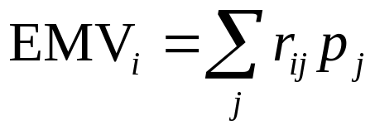
Expected Monetary Value (EMV)
The expected monetary value method selects the decision
alternative with the largest EMV. The EMV of
alternative i is given by
15-<number>

Slide 31
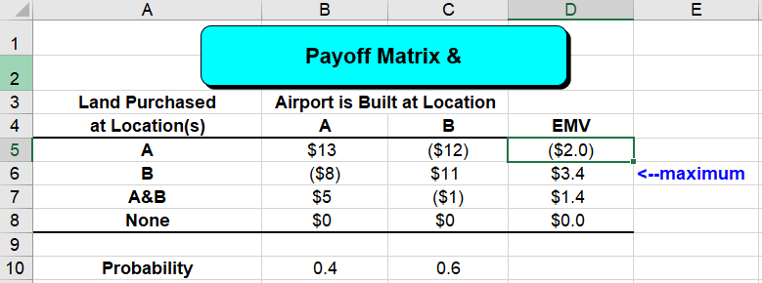
Expected Monetary Value
The EMV for a given decision alternative indicates the average payoff we would receive if we encounter the identical decision problem repeatedly and always select this alternative.
This decision rule can be very risky in decision problem encountered only once.
See file Fig15-1.xls
=SUMPRODUCT($B$10:$C$10,B5:C5)
15-<number>

Slide 32
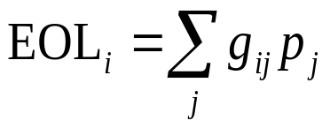
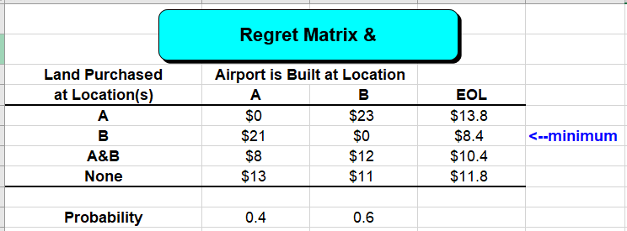
Expected Regret or Opportunity Loss
Selects alternative with the smallest expected regret or opportunity loss (EOL)
The decision with the largest EMV will also have the smallest EOL.
See file Fig15-1.xls
=MAX(Payoffs!B$5:B$8)-Payoffs!B5
15-<number>

Slide 33
The Expected Value of Perfect Information (EVPI)
One of the main difficulties in decision making is that we usually do not know which state of nature will occur.
Suppose, we could hire a consultant who could tell us in advance and with 100% accuracy which state of nature will occur, 40% of the time the consultant tells that the airport will be built at site A, and 60% of the time at site B.
15-<number>

Slide 34
The Expected Value of Perfect Information
With such perfect information, Magnolia Inns’ average payoff would be:
  EV with PI = 0.4*$13 + 0.6*$11 = $11.8 (in millions)
Without perfect information, the EMV was $3.4 million.
The expected value of perfect information is therefore,
  EV of PI = $11.8 - $3.4 = $8.4 (in millions)
In general, EV of PI = EV with PI - maximum EMV
It will always be the case that, EV of PI = minimum EOL
15-<number>

Slide 35
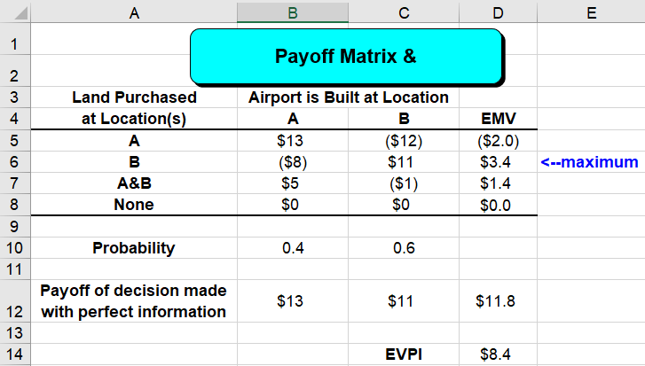
=MAX(B5:B8)
=SUMPRODUCT(B12:C12,$B$10:$C$10)
D12-MAX(D5:D8)
15-<number>

Slide 36
Decision/Event Trees
Synopsis: A decision/event tree is a graphical model showing the sequence of events in a problem.
Strength: Fairly simple to understand and construct, and able to show a high level of detail. Solution algorithm is simple.
Weakness: The size of the tree grows quite rapidly when there are many choices or possibilities.
15-<number>

Slide 37
Example of a Decision/Event Tree
Site 1
Demand
$$
Build new
warehouse
Site 2
Demand
$$
Lease space
$$
Select
location
Lease
price
Demand
Expand
current
facilities
Demand
$$
How much to
expand
15-<number>

Slide 38
Common Problems in Making Decision Trees
Determining the sequence of events
Confusion in determining the probabilities
15-<number>

Slide 39
Influence Diagrams vs.
Decision Trees
Decision Trees
Better at showing details
Becomes messy quite quickly
Good for showing sequence and steps
Straightforward solution algorithm
Influence Diagrams
Better at showing structure
Compact display of structure
Good for structuring phase
Complicated solution algorithm
15-<number>

Slide 40
Solving Decision Trees
Start with a structure to record sequence of events
Complete tree by adding probabilities for random events and determining payoffs for different scenarios
Can solve decision tree to determine optimal strategy to maximize (minimize) expected payoff
15-<number>

Slide 41
Oil Wildcatting
An oil wildcatter must decide whether or not to drill at a given site before his option expires. He must decide whether to drill (action a₁) or not to drill (action a₂). He is uncertain as to whether the hole is dry (state s₁), wet (state s₂), or soaking (state s₃).
15-<number>

Slide 42
State of the Oil Well
State
Prob
Dry (s
)
50%
1
Wet (s
)
30%
2
Soaking (s
)
20%
3

Slide 43
Payoffs for the Problem
Act
State
a
a
1
2
Dry (s
)
-$70,000
0
1
Wet (s
)
$50,000
0
2
Soaking (s
)
$200,000
0
3

Slide 44
Influence Diagram for Problem
Dry
Wet
Soaking
State of the
Oil Well
 | Drill | Don’t
Dry | -70 | 0
Wet | 50 | 0
Soak. | 200 | 0
Action
Payoff
Drill
Don’t Drill
15-<number>

Slide 45
Decision Tree for the Problem
Dry
50%
-$70,000
Wet
30%
Drill
$50,000
Soaking
20%
$200,000
Don’t Drill
$0
15-<number>

Slide 46
Solving the Decision Tree
Rolling-back
At random event nodes
  Record expected value of branches
At decision nodes
  Determine max (min) value of branches
  Record branch giving max (min) value
15-<number>

Slide 47
Folding Back at a Random Event Node
Dry
50%
-$70,000
Wet
30%
Drill
$50,000
=
Soaking
20%
$200,000
Drill
$20,000
E[Drill] = -70(0.5) + 50(0.3) + 200(0.2) = 20
15-<number>

Slide 48
After Collapsing the Random Event Node
Drill
$20,000
Don’t Drill
$0
15-<number>

Slide 49
Folding Back at a Decision Node
Drill
$20,000
Don’t Drill
=
$0
Drill
$20,000
Max($20,000, $0)
15-<number>

Slide 50
After Collapsing the Decision Node
Drill
$20,000
15-<number>

Slide 51
Solved Decision Tree
Dry
50%
$20,000
-$70,000
Wet
30%
$20,000
Drill
$50,000
Soaking
20%
$200,000
Don’t Drill
$0
15-<number>

Slide 52
A Decision Tree for Magnolia Inns
Land Purchase Decision
Airport Location
Payoff
A
13
Buy A
31
1
-18
6
-12
B
A
-8
Buy B
4
2
-12
23
B
11
0
A
35
5
Buy A&B
3
-30
29
B
-1
A
0
0
Buy nothing
4
0
0
B
0
15-<number>

Slide 53
Rolling Back A Decision Tree
Land Purchase Decision
Airport Location
Payoff
A
0.4
13
Buy A
31
1
-18
EMV=-2
6
-12
B
0.6
A
0.4
-8
Buy B
4
2
-12
EMV=3.4
23
B
11
0
0.6
A
0.4
5
Buy A&B
35
EMV=3.4
3
-30
EMV=1.4
29
B
-1
0.6
A
0.4
0
Buy nothing
0
4
0
EMV= 0
0
B
0
0.6
15-<number>

Slide 54
Alternate Decision Tree
Land Purchase Decision
Airport Location
Payoff
A
0.4
13
Buy A
31
1
-18
EMV=-2
6
-12
B
0.6
A
0.4
-8
Buy B
4
2
-12
EMV=3.4
23
B
11
0
0.6
A
0.4
5
Buy A&B
35
EMV=3.4
3
-30
EMV=1.4
29
B
-1
0.6
Buy nothing
0
0
15-<number>

Slide 55
Assignment -7
Chapter 15
Question no.: 3,4,5, 7,8,10,19,20,22
Due date: 21 July 2023
15-<number>

Slide 56
End of Chapter 15
15-<number>

